Slide 1
Queues
Sending messages through the system

Slide 2
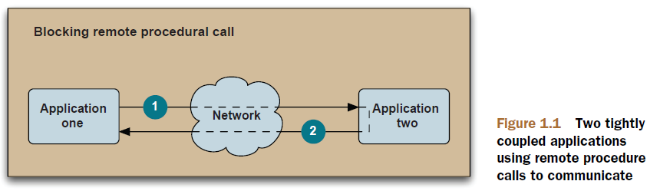
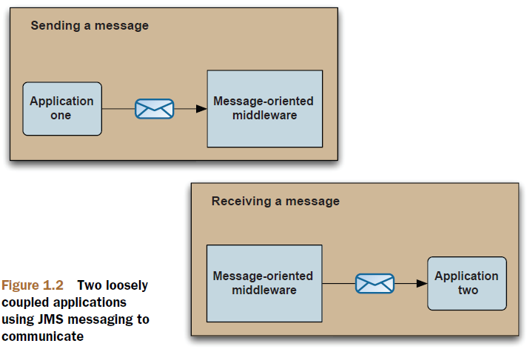
What is a Queue

Slide 3
When to use Queues
Heterogeneous application integration
As a replacement for RPC
To loosen the coupling between applications
As the backbone of an event-driven architecture
To improve application scalability

Slide 4


Queues – How does it work: Asynchronous communication
http is an example of synchronous communication; ajax of asynchronous communication
network
boundary
proces/thread 1
proces/thread 2
queue
queue
asynchronous communication: the requestor and the provider don’t have to interact with the queue at the same time
synchronous communication: the requestor has to wait for the response of the provider

Slide 5
Queues – How does it work: Message brokers
When specific actions are done with the message (routing, transformation validation, …) we are using a message broker
proces/thread 1
proces/thread 2
JMS Provider
JMS Provider: vendor specific middleware that makes access to the message possible by using the JMS API (like JDBC)

Slide 6
Queues – How does it work: Connecting
A message provider makes the ‘destination’ of a client.
WMQ
provider
Websphere MQ
JMS
API
ActiveMQ
provider
Apache ActiveMQ
producer
TIBCO
provider
TIBCO
SonicMQ
provider
SonicMQ
Notes:
After a message source, sink, or filter has been declared in the configuration file, it must be hooked up to JMS in order for its messages to go anywhere, or for it to receive messages. As discussed earlier, a messaging component is never connected directly to another component. Instead, a messaging component is hooked up to a JMS destination, maintained by one of the JMS providers registered with Patch Bay. Messaging components communicate with each other by hooking up to the same destination—if message source A sends messages to destination D, and message sink B receives messages from destination D, messages flow from A to B.

Slide 7
Queue Types
Who;s listening

Slide 8
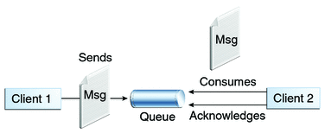
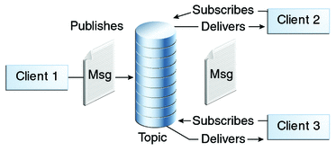
Queue Types: Two Options
Option 1: Point-to-Point Messaging
Option 2: Publish/Subscribe Messaging

Slide 9

Queue-types: The Point-to-Point Domain
producer
consumer
All messages are kept in the queue until they have been delivered or have become expired. The queue guarantees delivery through a round-robin principle.
A message will only be delivered once to one consumer.
consumer
queue
consumer
MessageConsumer.receive(); //synchronous
MessageConsumer.setMessageListener(); //asynchronous
Notes:
Bekijk de animatie voor beter begrip

Slide 10
Queue-types: The Publish/ Subscribe Domain
A consumer can subscribe for a certain Topic
producer
consumer
Messages are not by default stored in the Topic
consumer
Topic
Topic
consumer

Slide 11
JMS
The standard for setting up queues

Slide 12
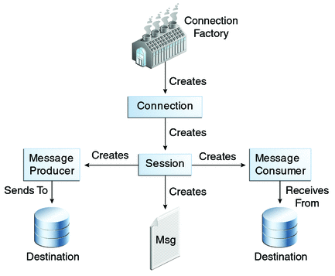
JMS Implementation

Slide 13
JMS implementation
A JMS Client can be both a producer and a consumer; in that case it implements both interfaces.
JMS Clients
proces/thread 1
proces/thread 2
Message Consumer
Message Producer
implements MessageProducer
implements MessageConsumer

Slide 14
JMS implementation
MessageProducer interface
Additional information is being set with DeliveryMode, Priority and Expiration
public interface MessageProducer {
void setDisableMessageID(boolean value) throws JMSException;
boolean getDisableMessageID() throws JMSException;
void setDisableMessageTimestamp(boolean value) throws JMSException;
boolean getDisableMessageTimestamp() throws JMSException;
void setDeliveryMode(int deliveryMode) throws JMSException;
Int getDeliveryMode() throws JMSException;
void setPriority(int defaultPriority) throws JMSException;
int getPriority() throws JMSException;
void setTimeToLive(long timeToLive) throws JMSException;
long getTimeToLive() throws JMSException;
Destination getDestination() throws JMSException; void close() throws JMSException;
void send(Message message) throws JMSException;
void send(Message message, int deliveryMode, int priority,long timeToLive) throws JMSException;
void send(Destination destination, Message message) throws JMSException;
void send(Destination destination,Message message,int deliveryMode,int priority,long timeToLive) throws JMSException;
}

Slide 15
JMS implementation
MessageConsumer interface
Synchronous reception is done with receive(), asynchronous with listener.
public interface MessageConsumer {
String getMessageSelector() throws JMSException;
MessageListener getMessageListener() throws JMSException;
void setMessageListener(MessageListener listener) throws JMSException;
Message receive() throws JMSException;
Message receive(long timeout) throws JMSException;
Message receiveNoWait() throws JMSException;
void close() throws JMSException;
}
The ´destination´ of the consumer is being set during session.createCustomer().

Slide 16
JMS implementation
JMS message is made to be easily understood. All complexity of a JMS message is found in the header.
JMS Message
Headers
JMSCorrelationID
JMSDeliveryMode
JMSDestination
JMSExpiration
JMSPriority
JMSRedelivered
JMSReployTo
JMSTimeStamp
...
Payload
Message
TextMessage
MapMessage
Bytemessage
StreamMessage
ObjectMessage

Slide 17
JMS implementation
Acquire a JMS connection factory
Create a JMS connection using this factory
Start the connection
Create a JMS session from the connection
Acquire a destination
Create a JMS producer
Create a JMS message and address it to a destination
Create a JMS consumer
Register a JMS message listener
Send or receive message(s)
Close all JMS resources (connection, session, producer, consumer, and so forth)

Slide 18
JMS implementation
Sending a JMS message
public class MyMessageProducer {
// initial code omitted
ConnectionFactory connectionFactory;
Connection connection;Session session;
Destination destination;
MessageProducer producer;
Message message;
boolean useTransaction = false;
try {
Context ctx = new InitialContext();
connectionFactory = (ConnectionFactory) ctx.lookup("ConnectionFactoryName");
connection = connectionFactory.createConnection();
connection.start();
session = connection.createSession(useTransaction,Session.AUTO_ACKNOWLEDGE);
destination = session.createQueue("TEST.QUEUE");
producer = session.createProducer(destination);
message = session.createTextMessage("this is a test");
producer.send(message);
} catch (JMSException jmsEx) {
// error handling here
} finally {
producer.close();
session.close();
connection.close();
}
}
Hier wordt de connectie gestart zodat de client kan communiceren met de message broker

Slide 19
Selecting Messages
You don’t have to hear everything

Slide 20
Selecting messages
Selectors use the headers of a message to decide wether or not to forward this message.
Selectors are conditional statements defined with the use of a subset of SQL92
msg type A
msg type B
msg type A
Message Producer
Message Consumer
Message Selector
msg type B
msg type C
msg type B
Selector syntax
Item | Value
Literals | Boolean; numbers
Identifiers | header or property field
Operators | AND, OR, LIKE, BETWEEN, =,<,>,<=.+>, ...

Slide 21
Selecting messages
public void sendStockMessage(Session session,
MessageProducer producer,
Destination destination,
String payload,
String symbol,
double price)
throws JMSException {
TextMessage textMessage = session.createTextMessage();
textMessage.setText(payload);
textMessage.setStringProperty("SYMBOL", symbol);
textMessage.setDoubleProperty("PRICE", price);
producer.send(destination, textMessage);
}
Depending on what has been set in the custom-property SYMBOL the message will be forwarded or not.
1
String selector = "SYMBOL='AAPL'";
MessageConsumer consumer = session.createConsumer(destination, selector);
2
String selector = "SYMBOL='AAPL' AND PRICE > " + getPreviousPrice();
MessageConsumer consumer = session.createConsumer(destination, selector);
String selector = "SYMBOL IN ('AAPL', 'CSCO') AND PRICE > " + getPreviousPrice() + " AND PE_RATIO < " + getCurrentAcceptedPriceToEarningsRatioThreshold();
MessageConsumer consumer = session.createConsumer(destination, selector);
3

